Slide 1
ANALYSIS ON COVID-19 PATIENT
WMU 122 PROJECT 2021/2022
Group G08

Slide 2
GROUP MEMBERS
01
NURUL AIN BINTI JALIL (LEADER)
03
KELLY CHONG HO YEE
02
NURUL AIN IRDINA BINTI NOROL AZHAR
04
ANG KAI YEN
School of Physics
School of Physics
School of Physics
School of Management

Slide 3
INTRODUCTION
Coronaviruses are a large family of viruses that are known to cause illness ranging from the common cold to more severe diseases such as Middle East Respiratory Syndrome (MERS) and Severe Acute Respiratory Syndrome (SARS).
A novel coronavirus (COVID-19) was identified in 2019 in Wuhan, China. This is a new coronavirus that has not been previously identified in humans.
.

Slide 4
PROBLEM STATEMENTS
How the government can provides a basis for establishing effective and strategic prevention and control measures, such as vaccine planning, targeted screening for high-risk populations, and strategic health education and promotion campaigns to control covid-19 transmission? The description of COVID-19 clusters in Malaysia has lacked evidence up to this point. This study aims to analyse COVID-19 in Malaysia in terms of the number of new cases, active cases, recovery cases, cases in each age group, cluster types, and vaccination data such as partially vaccinated, completely vaccinated, and booster for daily use in Malaysia

Slide 5
DATASET
The COVID-19 data in Malaysia was obtained from where the raw data was sourced from the Ministry of Health Malaysia (MoH) website named COVIDNOW. The starting dates for sets of data indicate the dates on which the cases were confirmed in this country,

Slide 6
Ethical Appropriateness During data collection
01
02
03
Time limitation
Restriction
Security

Slide 7
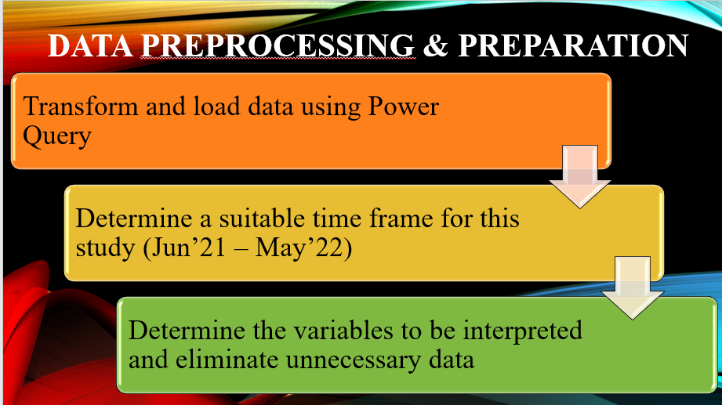

Slide 8
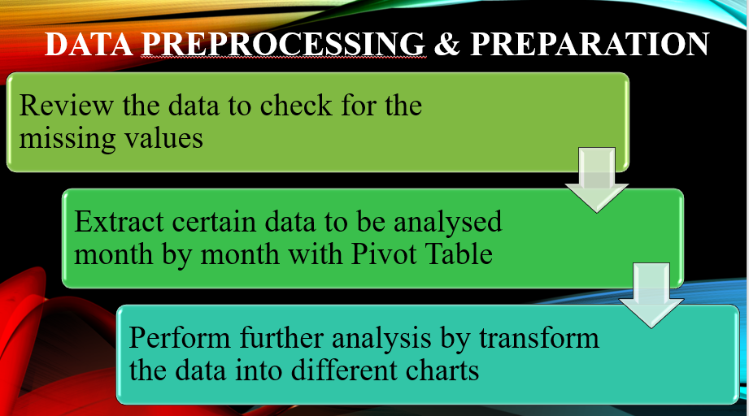

Slide 9
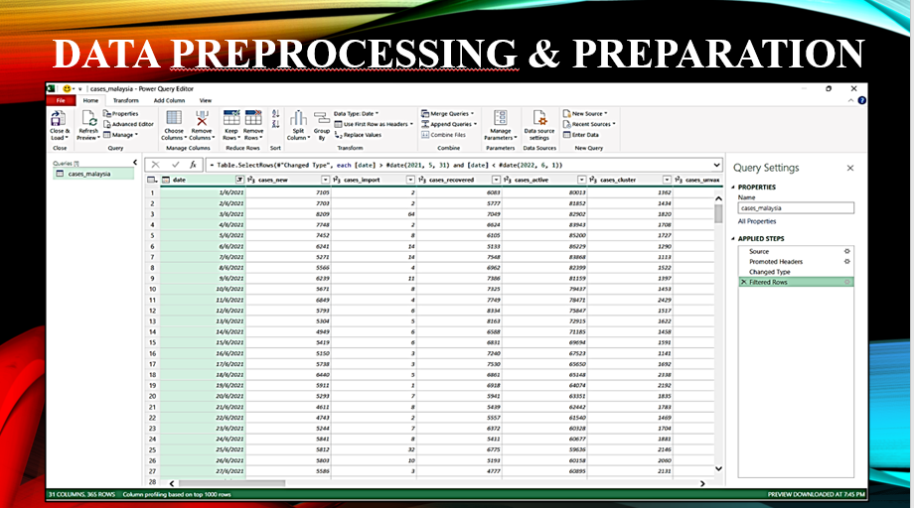

Slide 10
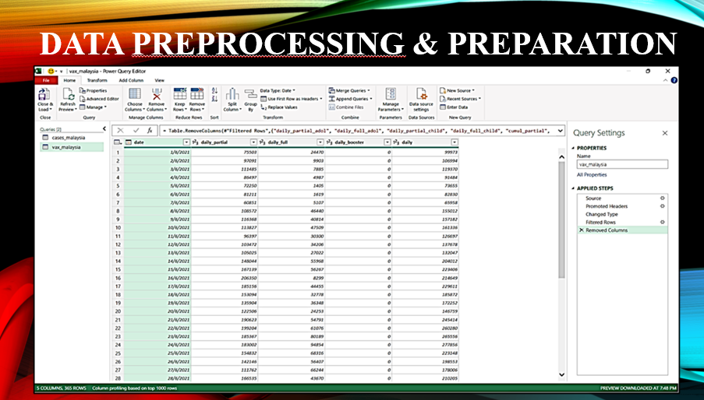

Slide 11
